Slide 1
Software Design Pattern
Topic : Builder Design Pattern
240160510008 – Desai Manish
240160510037 – Prajapati Praveen

Slide 2
Intent:
The Builder Design Pattern is a creational design pattern that is used to construct complex objects step by step. It allows you to create different representations of an object using the same construction process.

Slide 3
Motivation:
Sometimes, creating an object with many optional parameters can lead to messy and unreadable code. The Builder Pattern solves this problem by separating object construction from its representation, making the code cleaner and easier to maintain.

Slide 4
Structure diagram :
Director
SDLCBuilder
SDLCConcreteBuilder
SoftwareProject

Slide 5
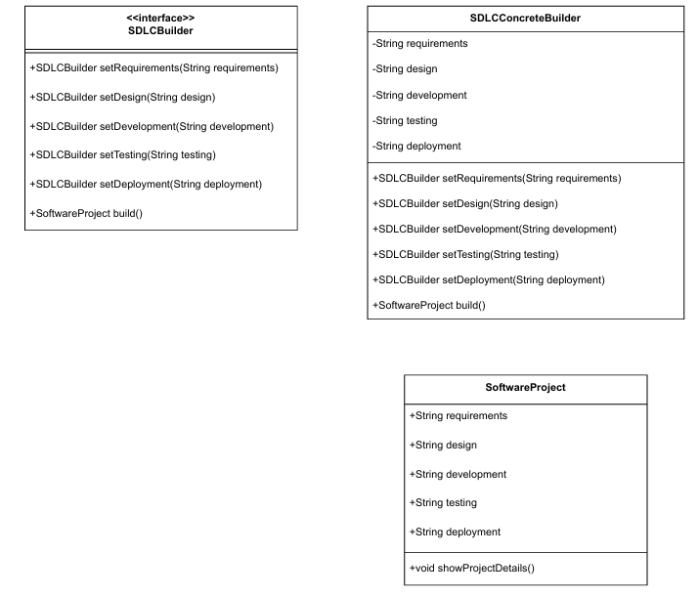
Class diagram :
+SoftwareProject(ConstructProject)
Director
Director

Slide 6
Role Of Particioent:
1. Builder Interface (SDLCBuilder)
Role: Defines the blueprint for building a complex object.
Responsibility: Declares methods to set different phases of software
development.
Ensures a step-by-step approach to object creation.
2. Concrete Builder (SDLCConcreteBuilder )
Role: Implements the builder interface to construct and assemble a
SoftwareProject.
Responsibility: Maintains an instance of SoftwareProject.
Implements methods to set each phase of the project.
Returns the final SoftwareProject object.
3. Product (SoftwareProject)
Role: The final complex object that is built.
Responsibility : Stores all information related to the software project.

Slide 7
Consequences:
Benefits:
1. Encapsulates Object Construction Logic
The builder class handles the complexity of object creation.
The client only cares about setting values without worrying about how the
object is built.
2. Allows Object Customization (Simple Explanation)
The Builder Pattern lets you create objects step by step, so you can choose
which parts to include and which to skip.
3. Step-by-Step Object Creation
The Builder Design Pattern is a creational design pattern that is used to
construct complex objects step by step.

Slide 8
Drawbacks :
1. More Code Complexity
The Builder Pattern requires extra classes (Builder, ConcreteBuilder,
Product).
For simple objects, using a constructor or setters is easier.
2. Slower Performance
Unlike a constructor, the builder creates objects in multiple steps, which
takes more time.

